Slide 1
The End of Disk? SSD and In-Memory Databases
MIS 64082 – Database Management and Database Analytics
Based on: Next Generation Databases: NoSQL, NewSQL, and Big Data by Guy Harrison, Copyright © 2015 by Guy Harrison
Adaptation - Copyright © 2019 by Alan Brandyberry

Slide 2
Speed of IO Operations
IO to magnetic disk devices has always been many orders of magnitude slower than memory or CPU access, and the situation has only grown worse as Moore’s law accelerated the performance of CPU and memory while leaving mechanical disk performance behind.
Solid State Disk – SSD
The emergence of affordable solid state disk (SSD) technology has allowed for a quantum leap in database disk performance.
In-Memory Solutions
Secondary storage (any kind of ‘storage device’) is not used except for backup. The database resides entirely in the server’s primary random-access storage (RAM)
No disk reads and writes?? This is a primary source of performance bottleneck. This would be expected to make the database throughput speed orders-of-magnitude faster than secondary-storage-based systems.

Slide 3
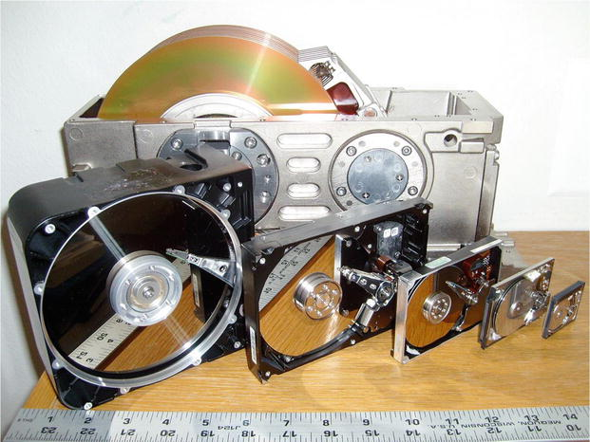
Figure 7-1. Disk devices over the years
Disks and other storage media have gotten smaller and faster over the years. However, CPU and RAM processing speeds have improved MUCH more than these secondary storage devices.
Reading from and writing to (IO) these devices is critical bottleneck for database processing.

Slide 4
Solid State Disk (SSD)
In contrast to a magnetic disk, solid state disks contain no moving parts and provide tremendously lower IO latencies. Commercial SSDs are currently implemented using either DDR RAM—effectively a battery-backed RAM device—or NAND flash. NAND flash is an inherently nonvolatile storage medium and almost completely dominates today’s SSD market.
Performance of flash SSD is on orders of magnitude superior to magnetic disk devices, especially for read operations. A random read from a high-end solid state disk may complete in as little as 25 microseconds, while a read from a magnetic disk may take up to 4,000 microseconds (4 milliseconds or 4/1000 of a second)—over 150 times slower.
While SSDs are certainly faster than magnetic disks, the speed improvement is not proportionate for all workloads. In particular, it costs more—takes longer—to modify information in an SSD than to read from it.

Slide 5
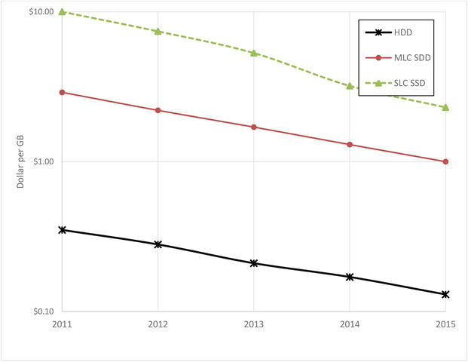
Figure 7-3. Trends in SSD and HDD storage costs (note logarithmic scale)
The promise of SSD has led some to anticipate a day when all magnetic disks are replaced by SSD. While this day may come, in the near term the economics of storage and the economics of I/O are at odds: magnetic disk technology provides a more economical medium per unit of storage, while flash technology provides a more economical medium for delivering high I/O rates and low latencies. And although the cost of a solid state disk is dropping rapidly, so is the cost of a magnetic disk. An examination of the trend for the cost per gigabyte for SSD and HDD is shown in Figure 7-3.

Slide 6
SSD-Enabled Databases
A couple of next-generation database systems have engineered architectures that are specifically designed to take advantage of the physics of SSD.
Many traditional relational databases perform relatively poorly on SSD because critical IO has been isolated to sequential write operations for which hard disk drives perform well, but that represent the worst possible workload for SSD.

Slide 7
In-Memory Databases
The solid state disk may have had a transformative impact on database performance, but it has resulted in only incremental changes for most database architectures. A more paradigm-shifting trend has been the increasing practicality of storing complete databases in main memory.

Slide 8
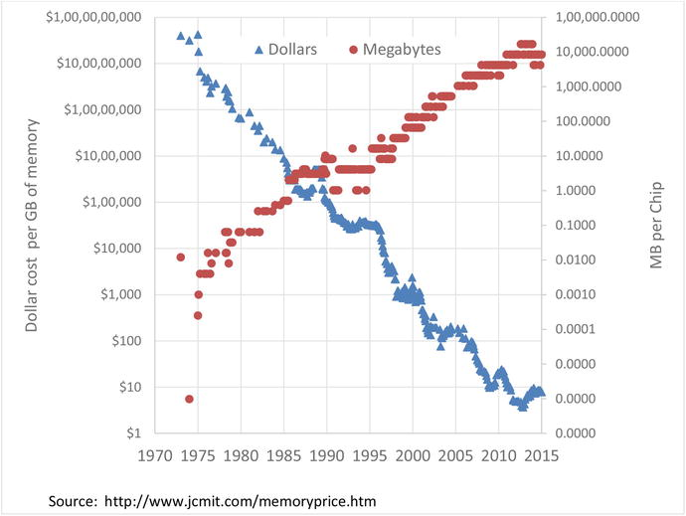
Figure 7-4. Trends for memory cost and capacity for the last 40 years
The cost of memory and the amount of memory that can be stored on a server have both been moving exponentially since the earliest days of computing. Figure 7-4 illustrates these trends: both the cost of memory per unit storage and the amount of storage that can fit on a single memory chip have been increasing over many decades (note the logarithmic scale—the relatively straight lines indicate exponential trends).

Slide 9
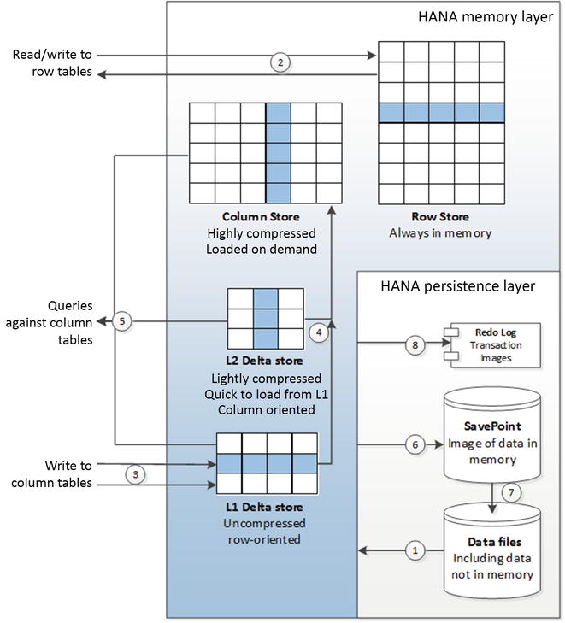
Figure 7-7. SAP HANA architecture
Figure 7-7 illustrates these key aspects of the HANA architecture. On start-up, row-based tables and selected column tables are loaded from the database files (1). Other column tables will be loaded on demand. Reads and writes to row-oriented tables can be applied directly (2). Updates to column-based tables will be buffered in the delta store (3), initially to the L1 row-oriented store. Data in the L1 store will consequently be promoted to the L2 store, and finally to the column store itself (4). Queries against column tables must read from both the delta store and the main column store (5).

Slide 10
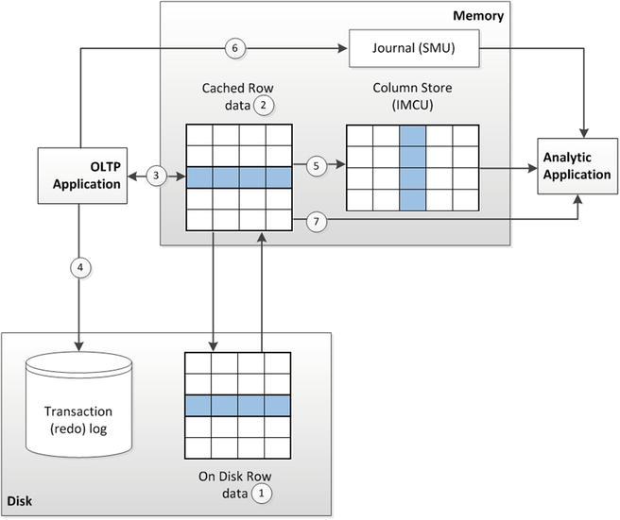
Figure 7-9. Oracle 12c “in-memory” architecture
Figure 7-9 illustrates the essential elements of the Oracle in-memory column store architecture. OLTP applications work with the database in the usual manner. Data is maintained in disk files (1), but cached in memory (2). An OLTP application primarily reads and writes from memory (3), but any committed transactions are written immediately to the transaction log on disk (4). When required or as configured, row data is loaded into a columnar representation for use by analytic applications (5). Any transactions that are committed once the data is loaded into columnar format are recorded in a journal (6), and analytic queries will consult the journal to determine if they need to read updated data from the row store (7) or possibly rebuild the columnar structure.

